Slide 1



Consumer Goods Analytics
Presented by Ashish Chauhan

Slide 2

AGENDA
Problem Statement & Project Overview
AtliQ Business Model
Data-Set
10 AD-Hoc Requests

Slide 3
ABOUT
ATLIQ
PROBLEM STATEMENT
PROJECT OVERVIEW
AtliQ Hardwares is a leading hardware company specializing in PC’s, Printers, Mice, and Computers with a global reach.
AtliQ Hardwares, a leading computer hardware producer, faced a critical challenge.
They need quick and data-informed decisions to stay competitive in the ever-evolving market.
The management noticed that they were missing crucial insights for strategic moves.
In this project, I will working with a dataset related to consumer goods.
The goal is to answer ten specific ad hoc requests using SQL queries.

Slide 4
ATLIQ HARDWARES BUSINESS MODEL
Customers
Customers Platforms
Croma
Brick and Mortar
E-commerce
Best Buy
Staples
Croma
Best Buy
Amazone
Flipkart
Flipkart

Slide 5
ATLIQ HARDWARES BUSINESS MODEL
Product Division
PC
N&S
P&A
Wifi Extenders
USB Flash Drivers
Processor
Motherboard
Personal Laptop
Gaming Laptop
Keyboard
Mouse
Product Segment
Storage
Peripherals
Notebook
Networking
Desktop
Accessories

Slide 6
DATA-SET
Dim Customer
TABLES
Dim Product
DATABASE
gdb023
Fact Gross Price
Fact Sales monthly
Fact Manufacturing cost
Fact Pre invoice deduction

Slide 7
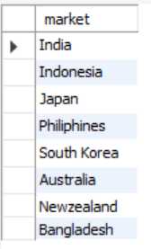
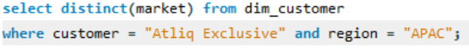
AD_HOC-REQUEST:1
QUESTION:
PROVIDE THE LIST OF MARKETS IN WHICH CUSTOMER "ATLIQ EXCLUSIVE" OPERATES ITS BUSINESS IN THE “APAC REGION”.
Output
SQL Query

Slide 8
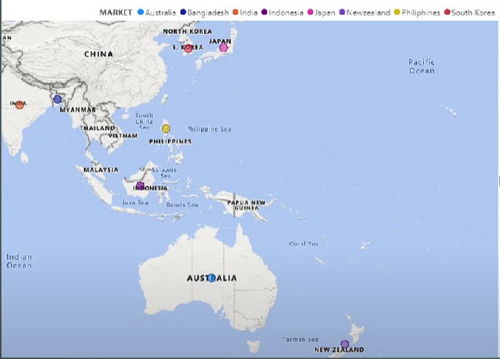
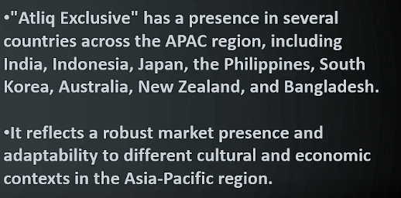
VISUALS - 1
iNSIGHTS

Slide 9
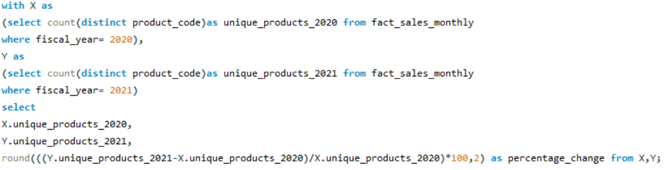
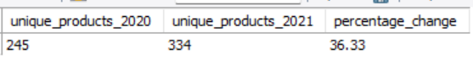
AD_HOC-REQUEST:2
QUESTION:
WHAT IS THE PERCENTAGE OF UNIQUE PRODUCT INCREASE IN 2021 VS. 2020? THE FINAL OUTPUT CONTAINS THESE FIELDS, UNIQUE_PRODUCTS_2020, UNIQUE_PRODUCTS_2021, PERCENTAGE_CHG.
Output
SQL Query

Slide 10
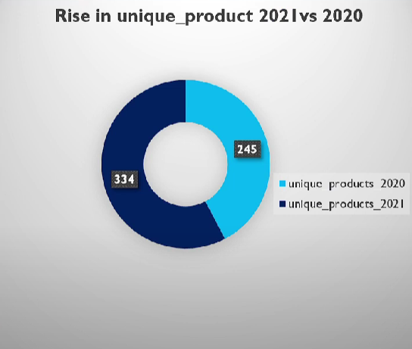
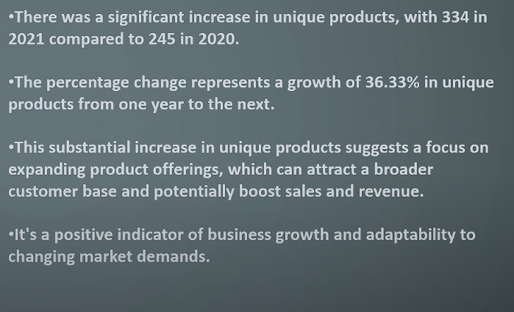
VISUALS - 2
iNSIGHTS

Slide 11
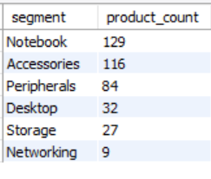
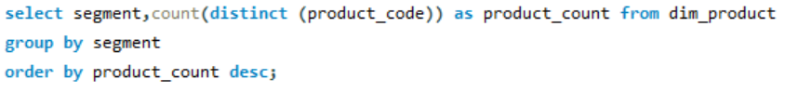
AD_HOC-REQUEST:3
QUESTION:
PROVIDE A REPORT WITH ALL THE UNIQUE PRODUCT COUNTS FOR EACH SEGMENT AND SORT THEM IN DESCENDING ORDER OF PRODUCT COUNTS. THE FINAL OUTPUT CONTAINS 2 FIELDS, SEGMENT, PRODUCT_COUNT.
Output
SQL Query

Slide 12
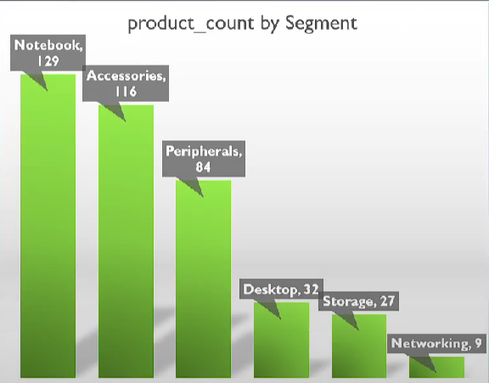
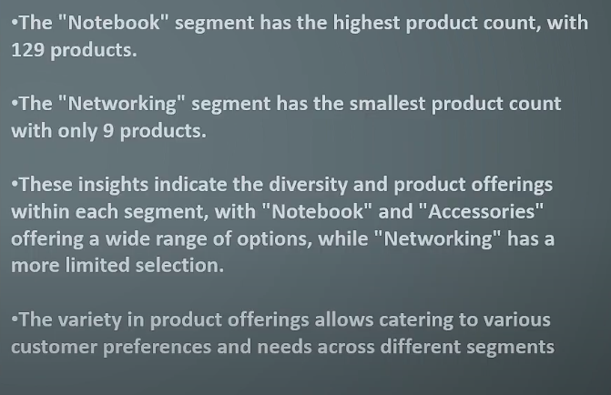
VISUALS - 3
iNSIGHTS

Slide 13
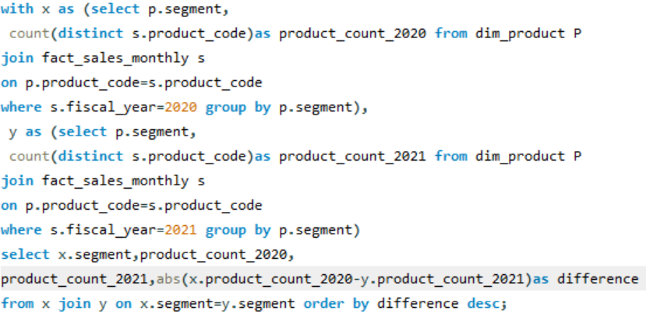
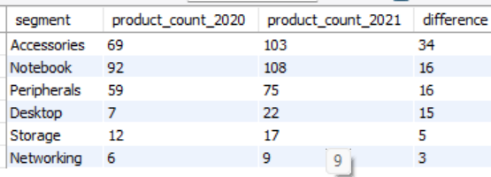
AD_HOC-REQUEST:4
QUESTION:
FOLLOW-UP: WHICH SEGMENT HAD THE MOST INCREASE IN UNIQUE PRODUCTS IN 2021 VS 2020? THE FINAL OUTPUT CONTAINS THESE FIELDS, SEGMENT, PRODUCT_COUNT_2020, PRODUCT_COUNT_2021, DIFFERENCE.
Output
SQL Query

Slide 14
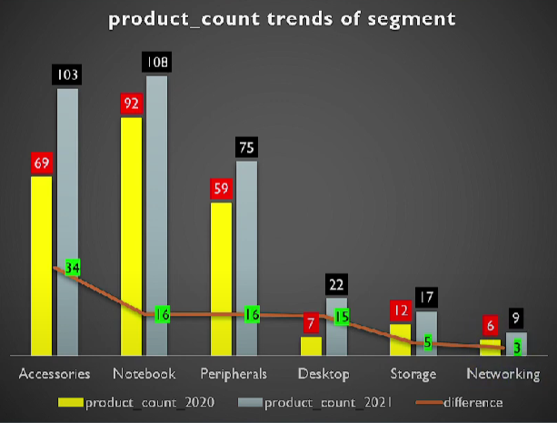
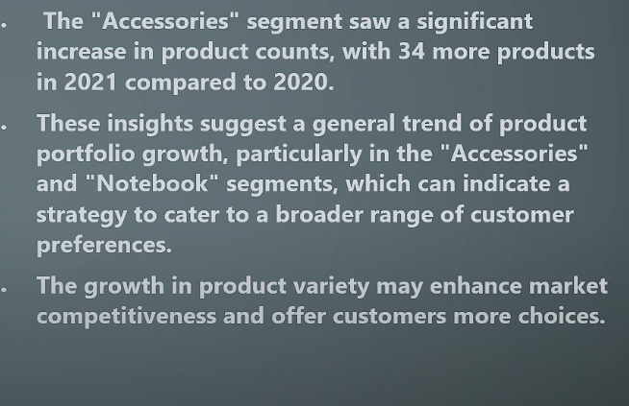
VISUALS - 4
iNSIGHTS

Slide 15
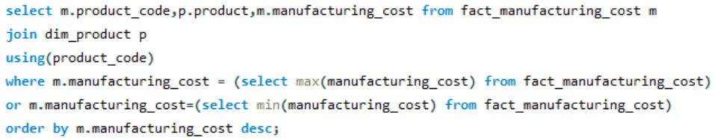
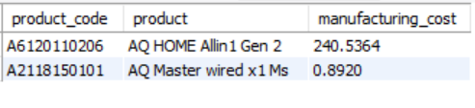
AD_HOC-REQUEST:5
QUESTION:
GET THE PRODUCTS THAT HAVE THE HIGHEST AND LOWEST MANUFACTURING COSTS. The final output should contain these fields, product_code, product, manufacturing_cost.
Output
SQL Query

Slide 16
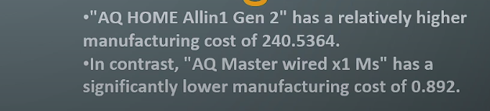
VISUALS - 5
iNSIGHTS

Slide 17
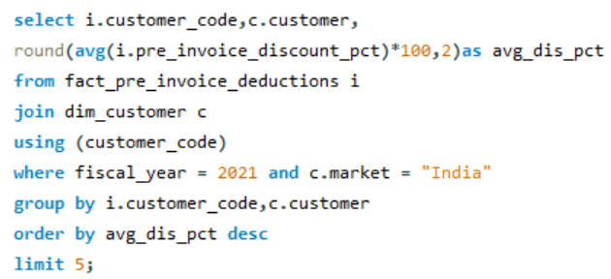
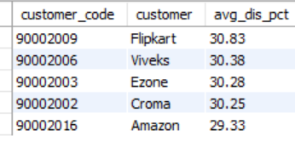
AD_HOC-REQUEST:6
QUESTION:
GENERATE A REPORT WHICH CONTAINS THE TOP 5 CUSTOMERS WHO RECEIVED AN AVERAGE HIGH PRE_INVOICE_DISCOUNT_PCT FOR THE FISCAL YEAR 2021
and in the Indian market. The final output contains these fields, customer_code, customer, average_discount_percentage.
SQL Query
Output

Slide 18
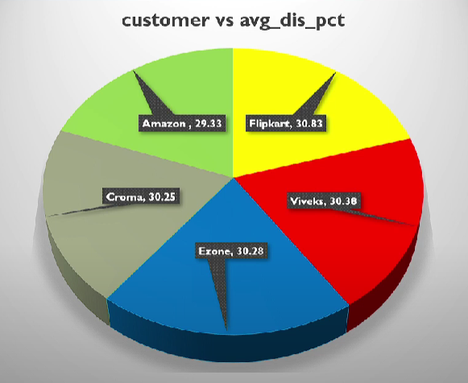
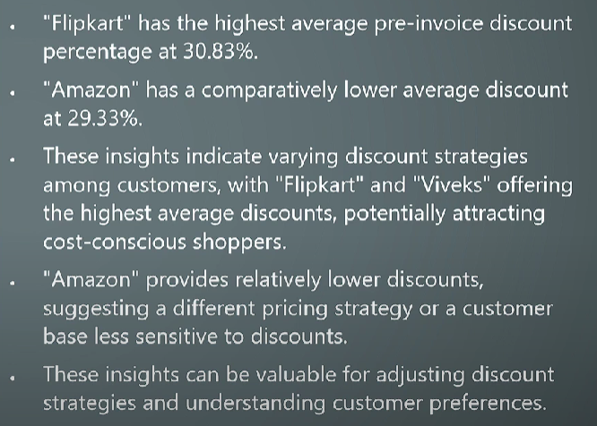
VISUALS - 6
iNSIGHTS

Slide 19
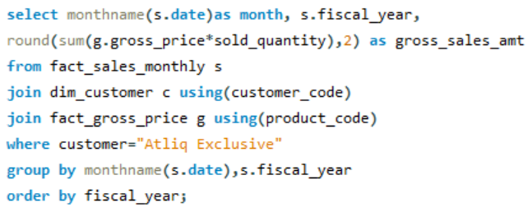
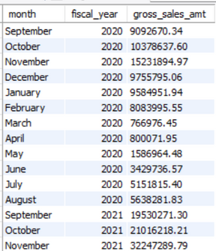
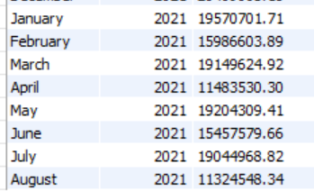
AD_HOC-REQUEST:7
QUESTION:
GET THE COMPLETE REPORT OF THE GROSS SALES AMOUNT FOR THE CUSTOMER “ATLIQ EXCLUSIVE” FOR EACH MONTH.
This analysis helps to get an idea of low and high-performing months and take strategic decisions.
The final report contains these columns: Month, Year, Gross sales Amount.
SQL Query
Output

Slide 20
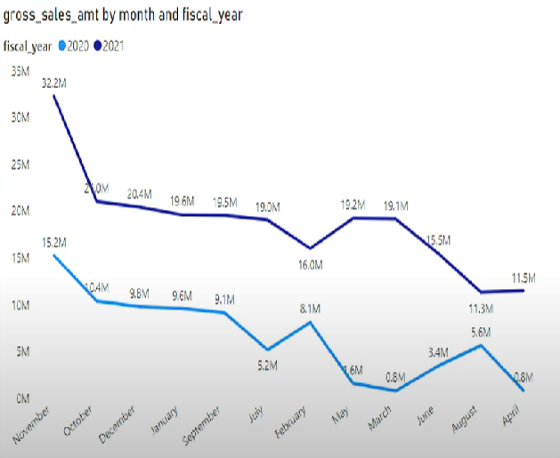
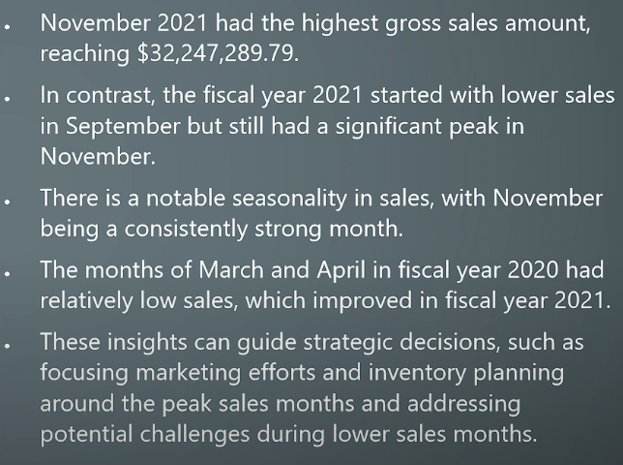
VISUALS - 7
iNSIGHTS

Slide 21
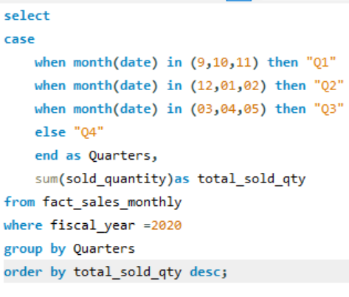
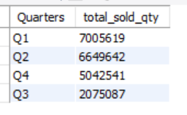
AD_HOC-REQUEST:8
QUESTION:
IN WHICH QUARTER OF 2020, GOT THE MAXIMUM TOTAL_SOLD_QUANTITY?
The final output contains these fields sorted by the total_sold_quantity, Quarter, total_sold_quantity.
SQL Query
Output

Slide 22
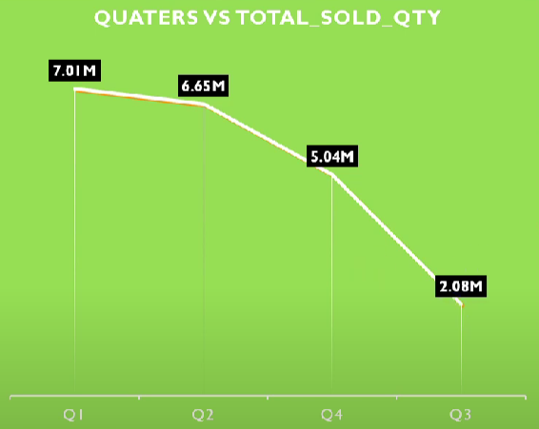
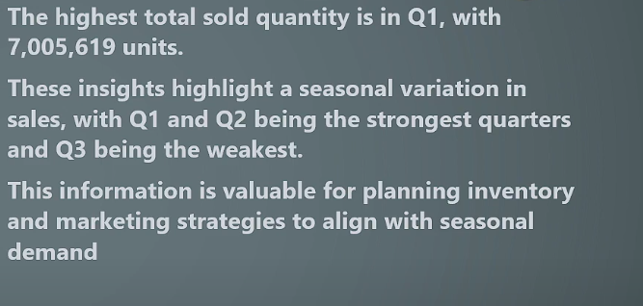
VISUALS - 8
iNSIGHTS

Slide 23
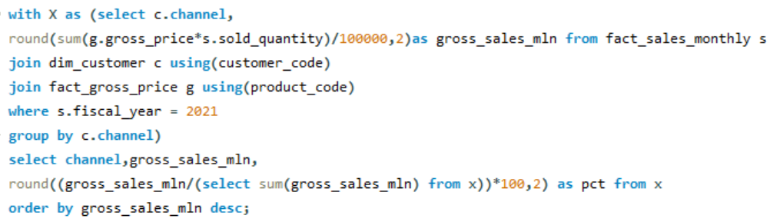
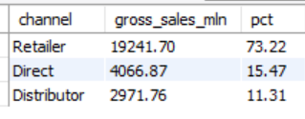
AD_HOC-REQUEST:9
QUESTION:
WHICH CHANNEL HELPED TO BRING MORE GROSS SALES IN THE FISCAL YEAR 2021 AND THE PERCENTAGE OF CONTRIBUTION?
The final output contains these fields, channel, gross_sales_mln, percentage.
SQL Query
Output

Slide 24
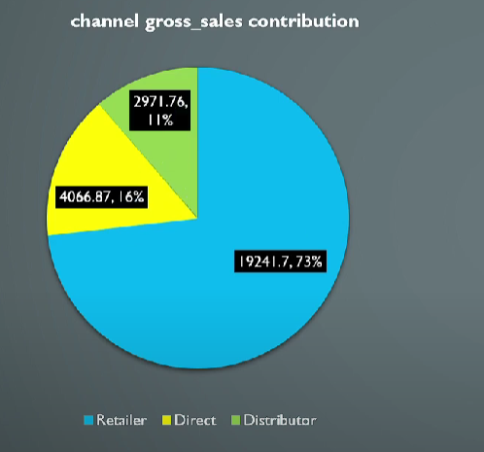
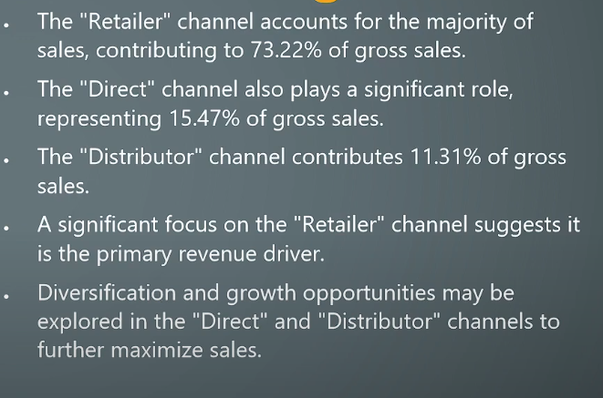
VISUALS - 9
iNSIGHTS

Slide 25
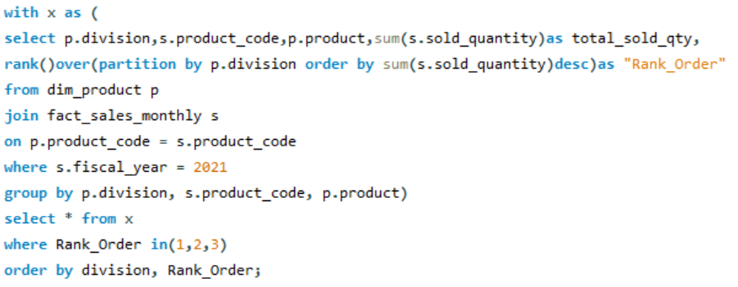
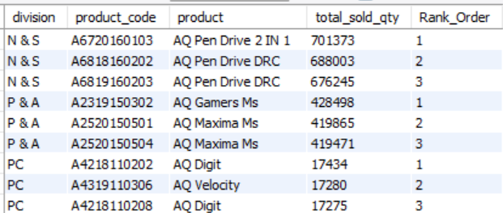
AD_HOC-REQUEST:10
QUESTION:
GET THE TOP 3 PRODUCTS IN EACH DIVISION THAT HAVE A HIGH TOTAL_SOLD_QUANTITY IN THE FISCAL_YEAR 2021?
The final output contains these fields, division, product_code, product, total_sold_quantity, rank_order.
SQL Query
Output

Slide 26
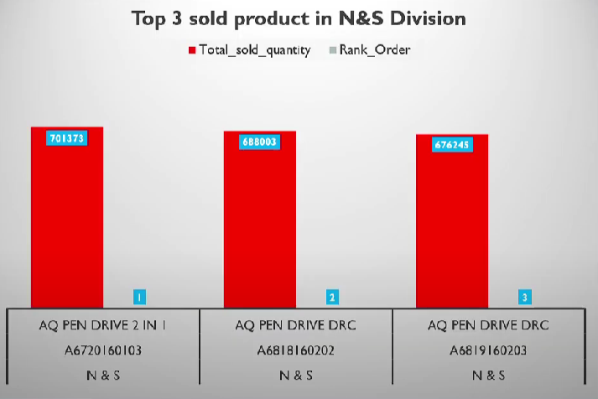
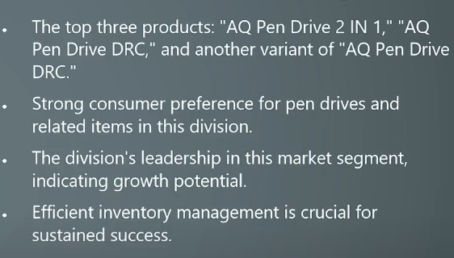
VISUALS - 10
iNSIGHTS

Slide 27

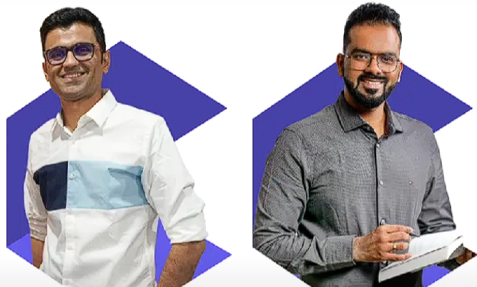

Dhavel Patel
Hemanand Vadivel
you
thank

